Slide 1
CS174A Lecture 13

Slide 2
Announcements & Reminders
2/25/24: A3 due; will be discussed during this week’s TA session
3/06/24: A4 due; will be discussed during this week’s TA session
3/07/23: Prof Demetri’s presentation (Zoom, no recording)
Team Project Timelines: see project info document on Canvas
Team project grade increased from 150 to 175 (download latest team project info)
3/19/24: Final exam, 6:30-8:15 PM, in person, location TBD
Final exam grade reduced from 150 to 125 (download latest syllabus)
Study guide and book exercises posted
3/18 & 3/19: Office hours, Noon-1PM

Slide 3
Discussion Session This Friday
Team project
Assignment #3
Assignment #4

Slide 4
Last Lecture Recap
Barycentric Coordinates, Bilinear Interpolations
Flat and Smooth Shading

Slide 5
Next Up
Non-Photorealistic Rendering
Global Illumination
Mappings: Texture, Bump, Displacement, Environment
Shadows
Shadow volumes
2-pass z-buffer algorithm
Hidden Surface Removal
Ray casting

Slide 6
Shading Recap
Flat Shading
Illuminate a poly only once
No interpolation
Gouraud Shading
Illuminate vertices of poly
Interpolate colors at vertices
Phong Shading
Illuminate each point inside poly
Interpolate normals at vertices
Illumination in WS/ES, interpolation in SS

Slide 7
Illumination Recap
I = k_{a} * I_{a} * O_{d} + f_{att} * k_{d} * I_{p} * (N·L) * O_{d} + f_{att} * k_{s} * I_{p} * (R·V)^{n}
Material Properties: k_{a}, k_{d}, k_{s}: ambient, diffuse, specular reflection coefficients of object O_{d}: color of object I_{a}: intensity of ambient light I_{p}: intensity of point light
n: specular exponent
Geometric Properties: N: orientation of object at point being illuminated L: depends on location of point and light R: depends on N and L V: depends on location of point and eye f_{att}: depends on distance between point and light
A_{att}: depends on distance between point and eye

Slide 8
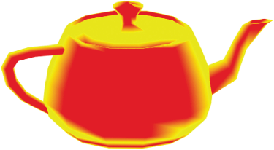
Non-Photorealistic Shading
Cartoon like effects
Color = (N·L > 0.5) ? Color1 : Color2
Color changes with object’s shape and light’s position
Silhouette: (N·V < 0.01) ? Black : Color

Slide 9
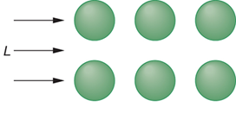
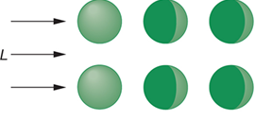
Global Illumination
Ray Tracing: shadows, reflections, refractions
Radiosity
Based upon light energy conservation
Requires solution of a large set of equations involving all surfaces

Slide 10
Mappings
Texture Mapping
Bump Mapping
Displacement Mapping
Environment Mapping
Procedural Mapping

Slide 11
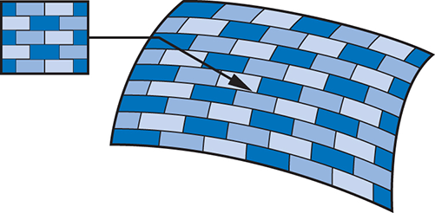
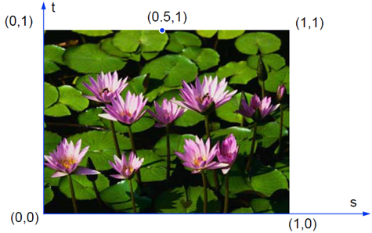
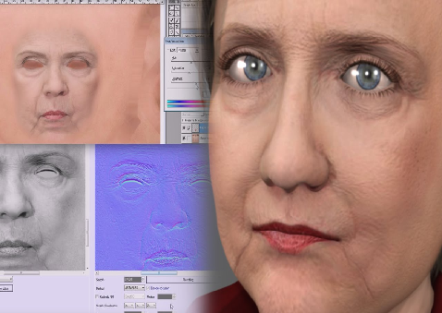
Texture Mapping
AKA Pattern mapping
Map a digitized image onto a poly face
Individual elements are called Texels
u,v and s,t coordinates
Use texel color as diffuse color
Texture replication (as in A4)

Slide 12
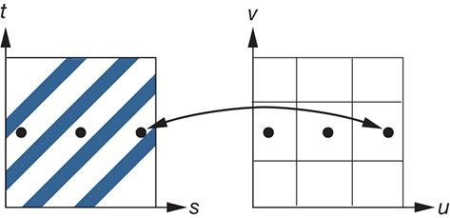
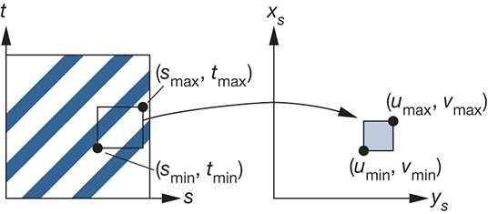
Texture Mapping: Aliasing
Due to high-frequency patterns
Mip Mapping (as in A4); MipMap, MipMap example

Slide 13
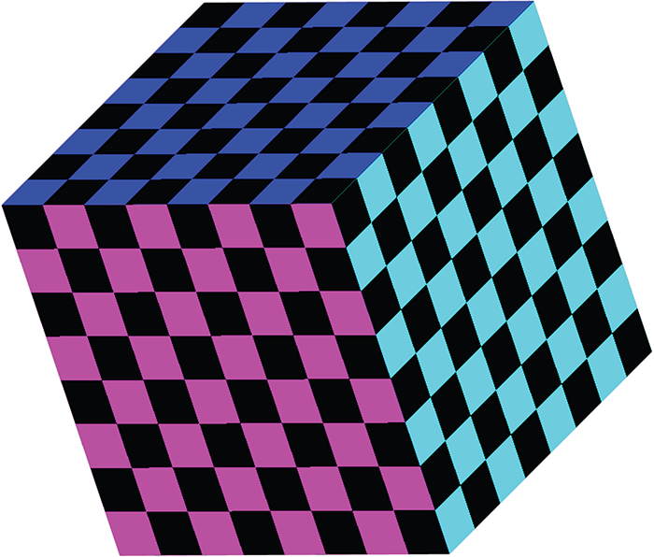
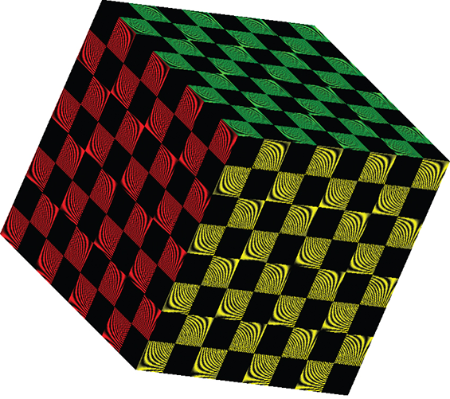
Multi-Texturing
Apply multiple textures on the same object – blend

Slide 14
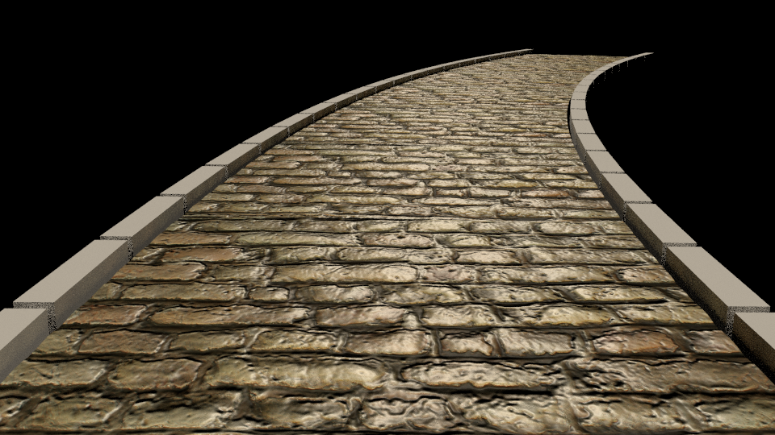
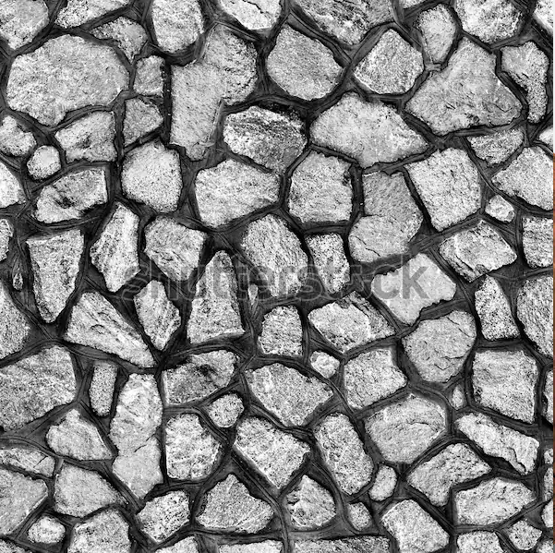
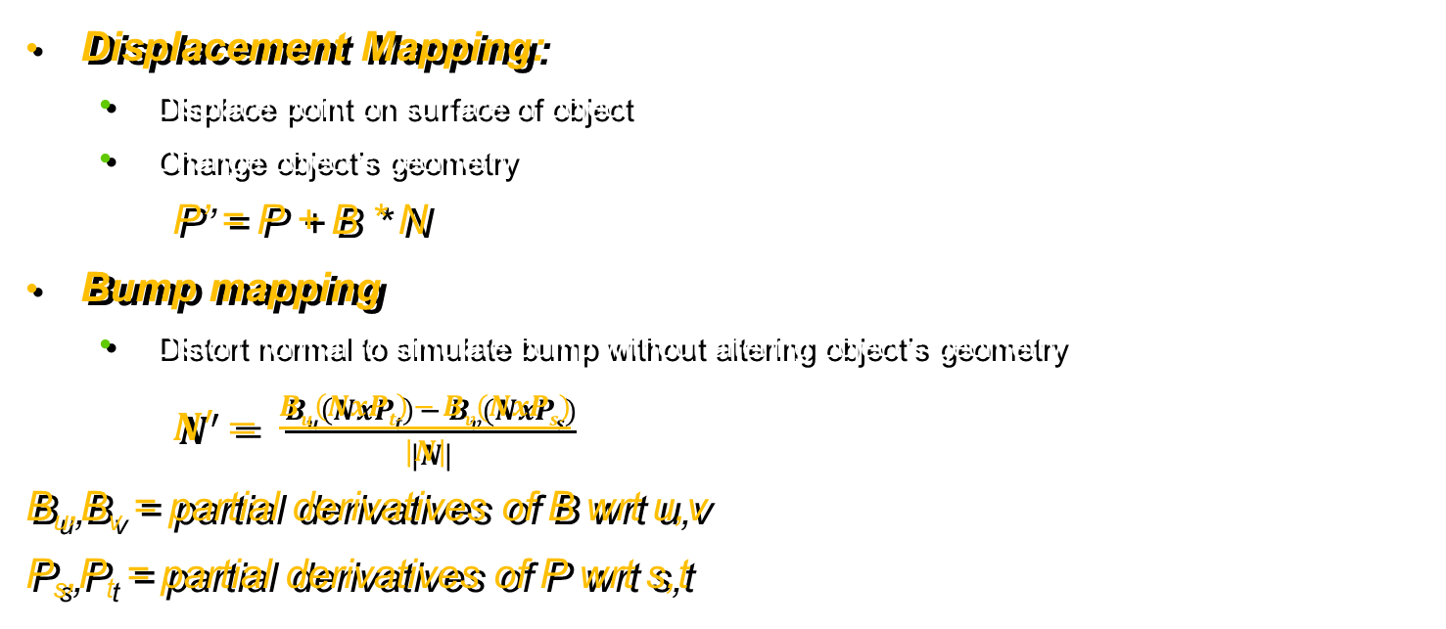
Bump & Displacement Mappings
Displacement Mapping:
Displace point on surface of object
Change object’s geometry
P’ = P + B * N
Bump mapping
Distort normal to simulate bump without altering object’s geometry
$N^{′}= \frac{Bu\left(NxPt\right) − Bv(NxPs)}{|N|}$
B_{u},B_{v} = partial derivatives of B wrt u,v
P_{s},P_{t} = partial derivatives of P wrt s,t

Slide 15
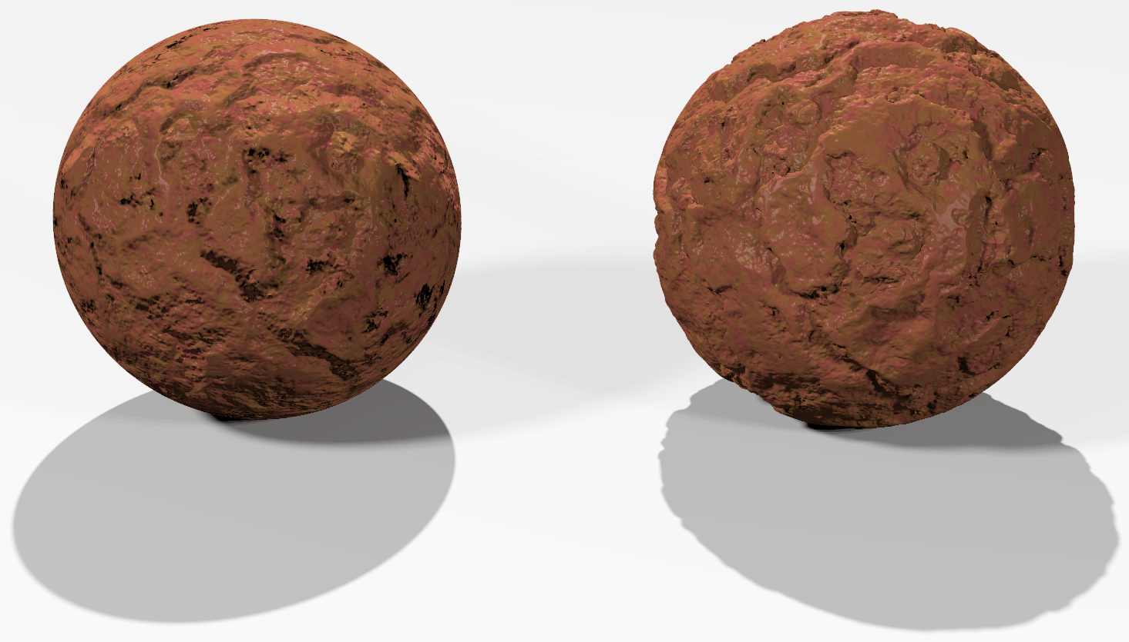
Displacement Mapping
Points actually move
Requires hidden surface removal
Bump vs. Displacement 1
Bump vs. Displacement 2

Slide 16


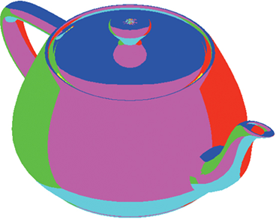
Environmental Mapping
AKA Reflection Mapping
Use polar (or spherical) coordinates of reflected ray to map
Map defined usually on 6 faces of a box (cube map) or a sphere

Slide 17
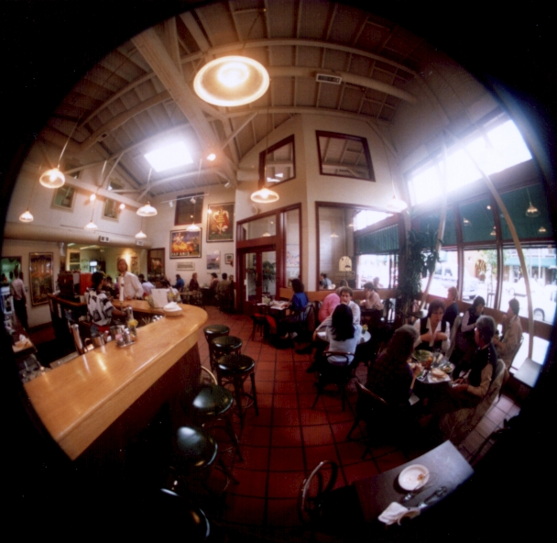
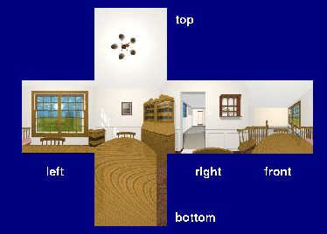
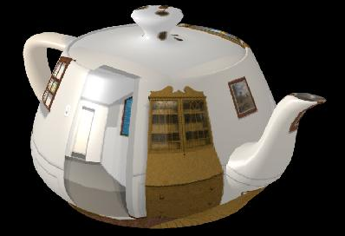
Environmental Mapping
More examples
I = ambient + diffuse + specular + k_{r} * I_{r}
k_{r}: coefficient of reflection
I_{r}: reflection intensity

Slide 18
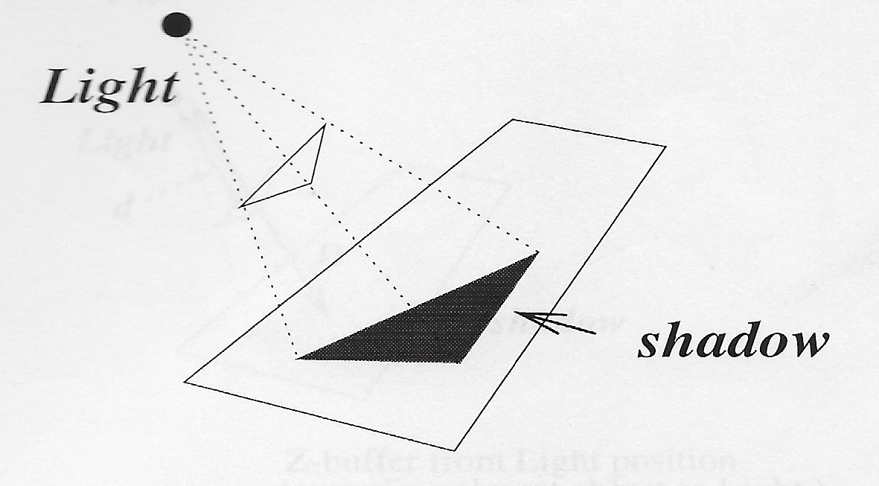
Shadow Algorithms
Types
Object precision: shadow volume method
Image precision: 2-pass z-buffer method
Main Idea
P is not visible from light source ⇔ P is in shadow
Strategy
Identify areas on polys which are not directly visible from light source
Mark these areas
Do HSR from eye position
Areas marked for shadow are rendered only with ambient light

Slide 19
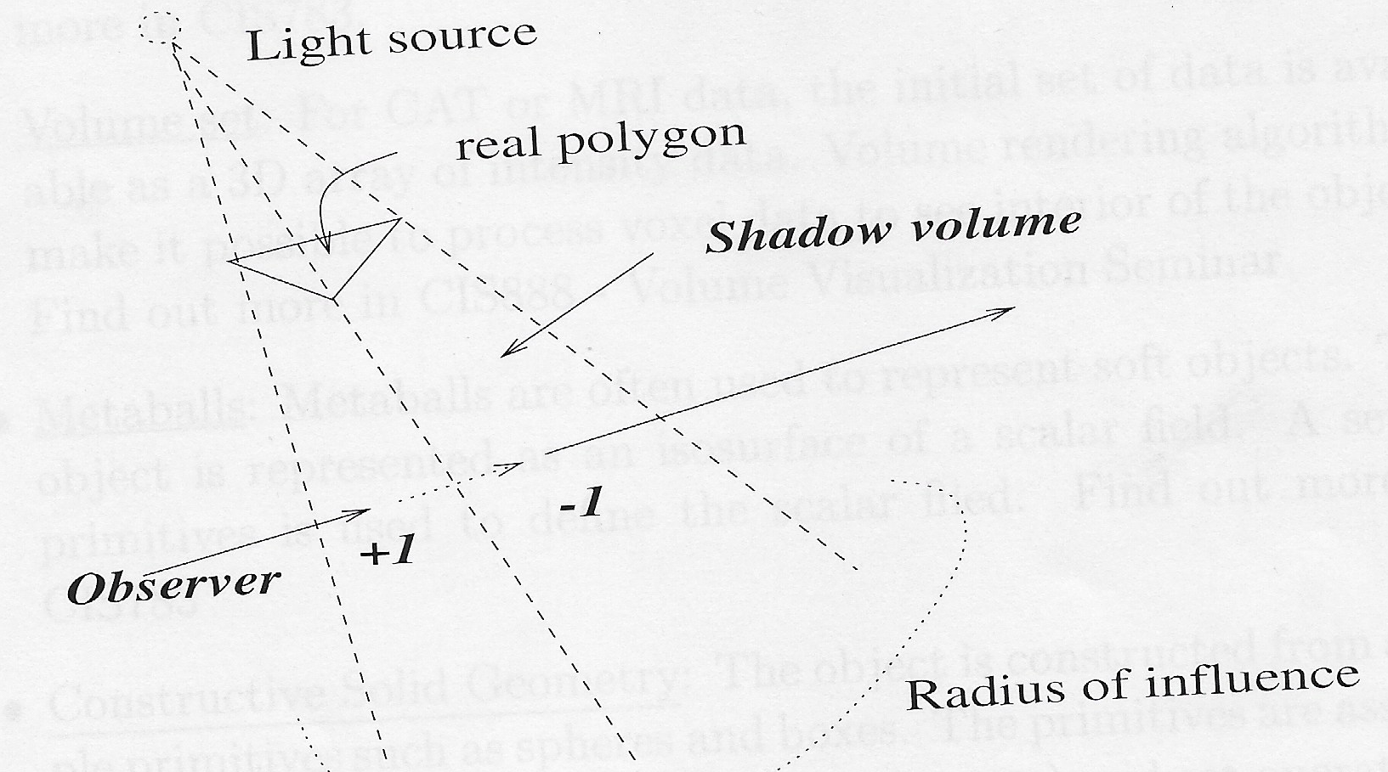
Shadow Volume Method
Create a shadow volume for each front facing poly
Put shadow volume in poly database
Do parity test to determine if a visible point is in shadow
Initial value = # of shadow volumes containing eye position
Increment for front-facing shadow poly
Decrement for back-facing shadow poly
If parity > 0 ⇒ point is in shadow

Slide 20
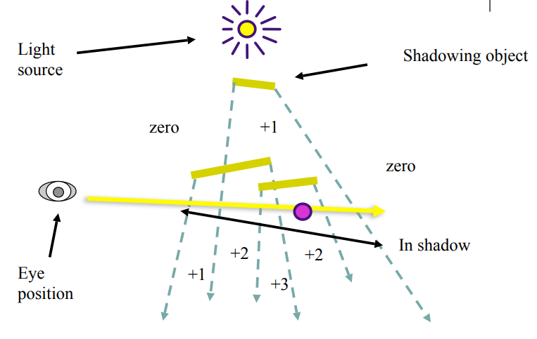
Shadow Volume Method

Slide 21
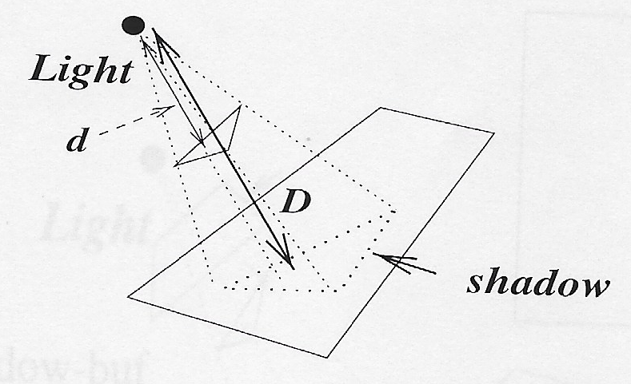
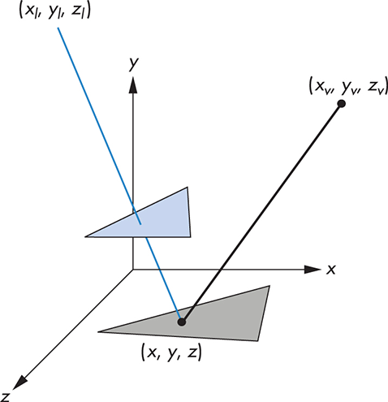
2-Pass Z-Buffer Method
Aka Shadow Map method
Do z-buffer (full) from light position
store results in shadow buffer or depth buffer
Do z-buffer (scanline or full) from eye position
For each (visible) pixel in scanline
Do inverse map point to WS
Map to SS of shadow buffer
Compare z with that of shadow buffer at x,y
If shadow_buf[x][y] < z, then point is in shadow

Slide 22
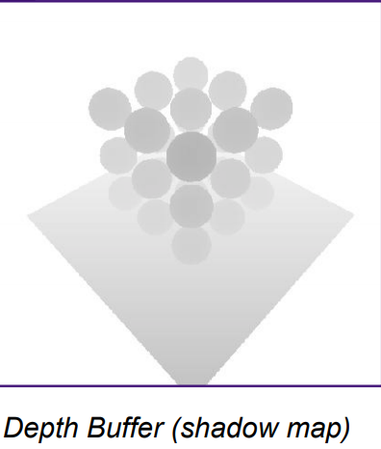
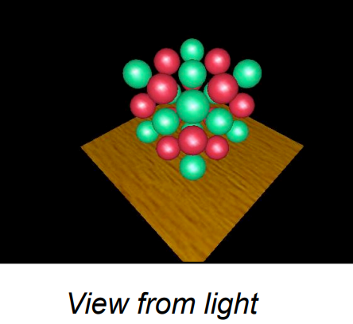
2-Pass Z-Buffer Method
First Pass: from light’s position

Slide 23
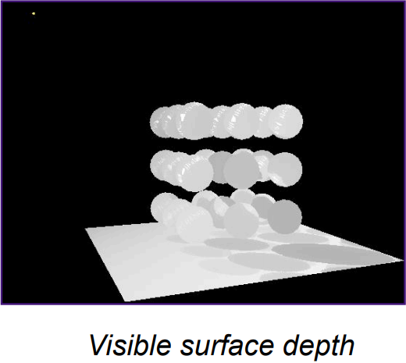
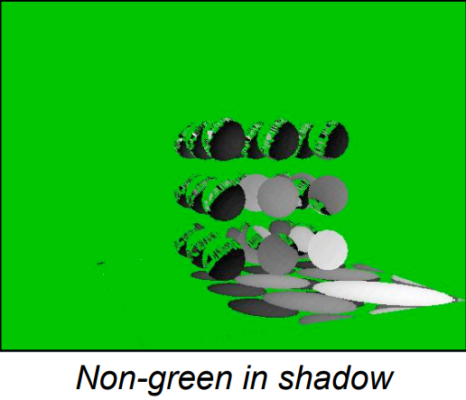
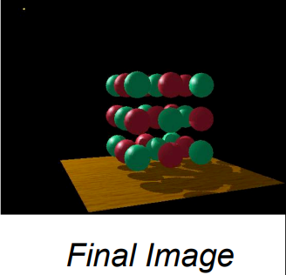
2-Pass Z-Buffer Method
Second Pass: from eye’s position
ShadowMap Viewer

Slide 24
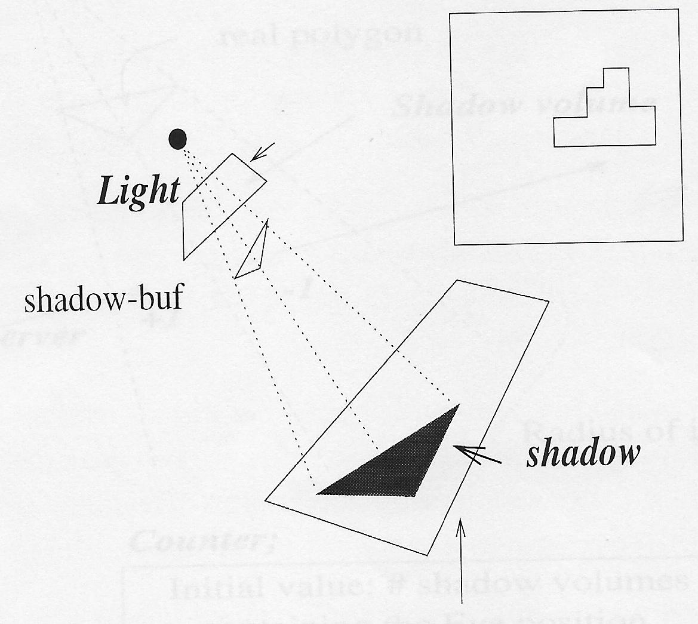
2-Pass Z-Buffer Method (Contd.)
Advantages
Simple to implement
Disadvantages
Shadow distant from light source may appear blocky
A large size of shadow-buffer is required
Depth buffer bit resolution – usually 8-bit
Umbra vs. penumbra

